Slide 1

SG ScamWISE
Module 1:
Digital Literacy

Slide 2


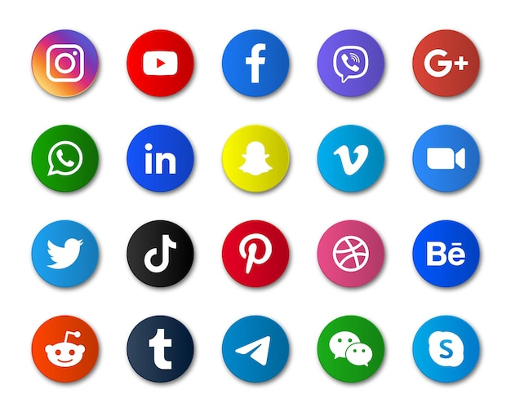

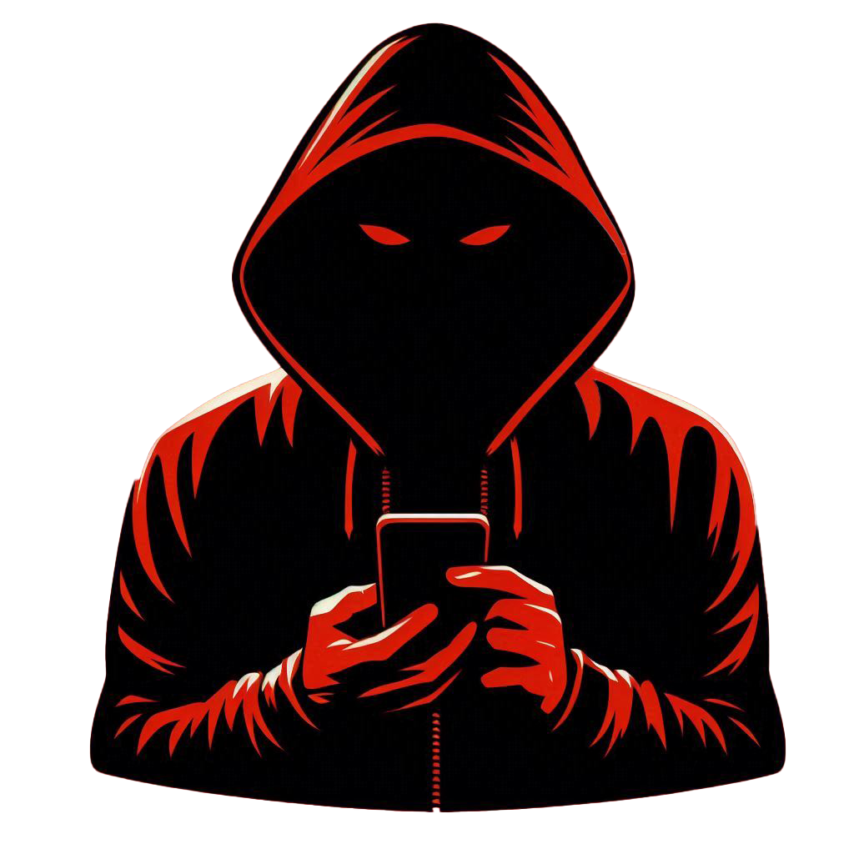

Technology
Through tech
apps, families
can stay updated about one
another’s lives anytime,
anywhere…
Good or Bad?
…but all this shared data provides ‘fuel’ for bad actors to exploit.

Slide 3

How your Digital Footprint can be EXPLOITED

Slide 4
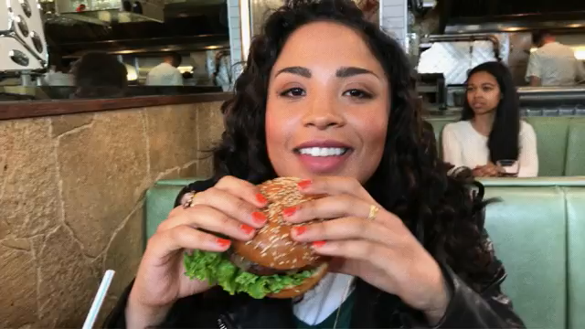
Source: https://youtu.be/w2tW50CD6Aw
Notes:
https://www.youtube.com/watch?v=w2tW50CD6Aw

Slide 5
What are your thoughts
after viewing this video?

Slide 6

Did You Know?
Your Name.
Your NRIC.
Your Phone Number.
Your Bank Account Number.
Your Home Address.
Your Email Address.
Your Family Members’ Information.
What data can be exploited by scammers?

Slide 7



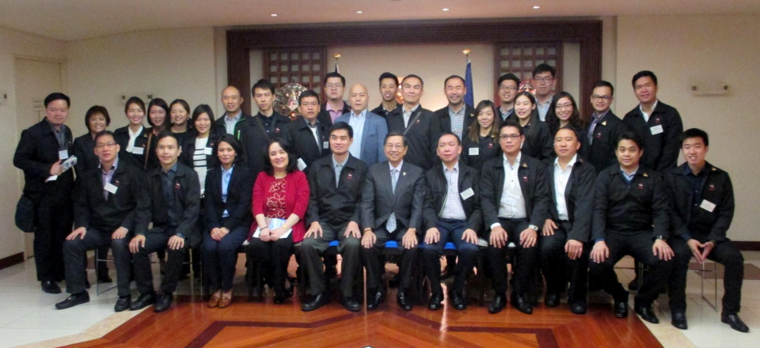
Benefits of
a Digital
Footprint
Sense of belonging
and relationships
Education and scholarship
Employment and
income
Networks and affiliations

Slide 8

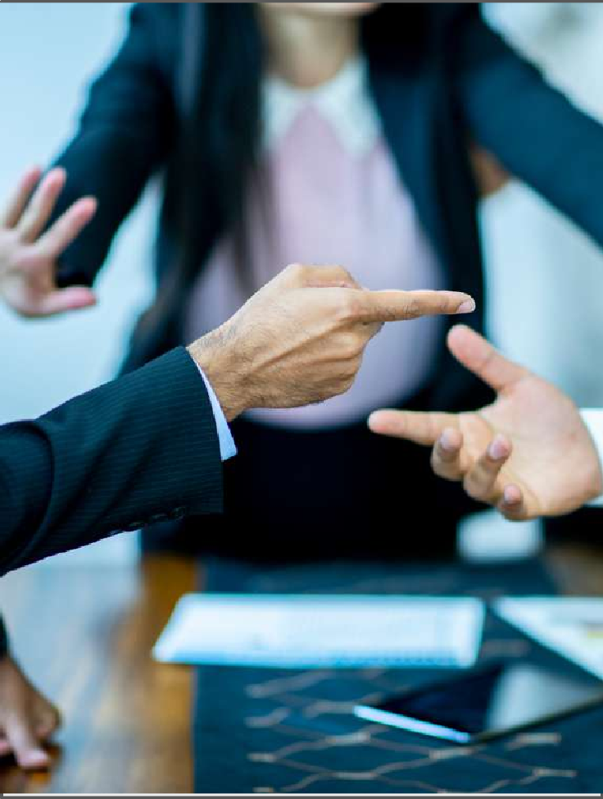

But did you know?
Becoming a victim of:
Risks of
a Digital
Footprint
Cyberbullying
Controversy
Cybercrime

Slide 9
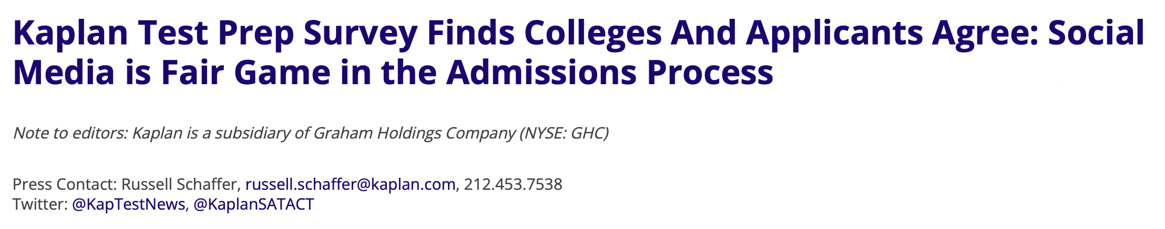
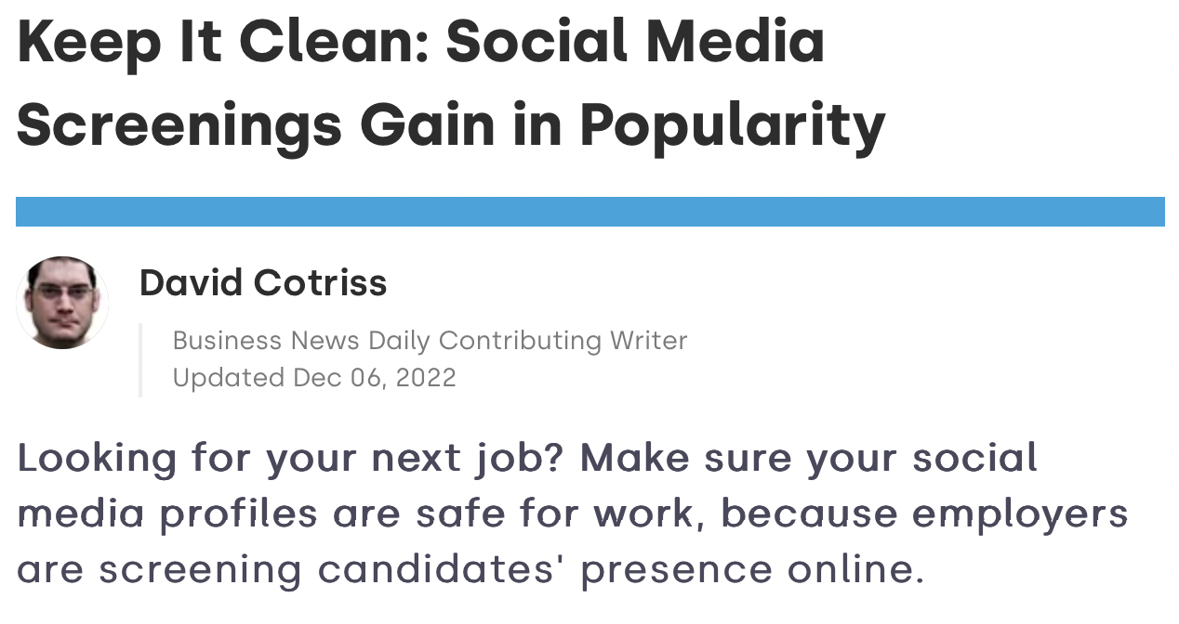
Real cases!
Risks of
a Digital
Footprint
Source: Kaplan Test Prep (2018)
Source: Business News Daily (2020)

Slide 10
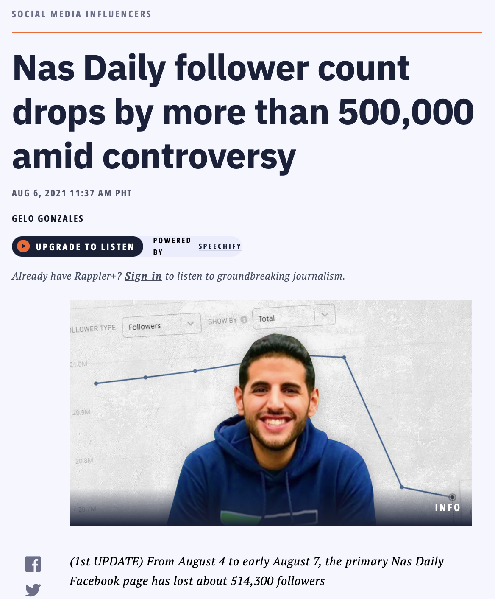
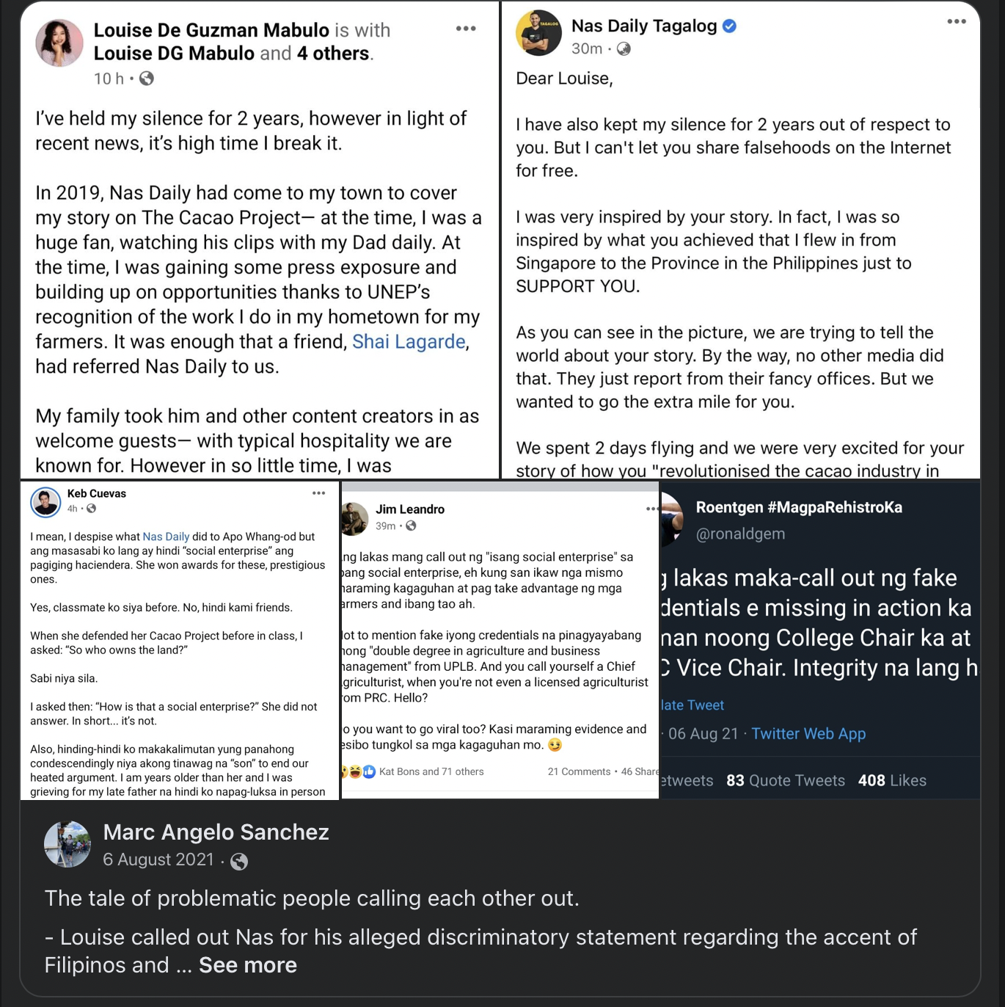
Real cases!
Risks of
a Digital
Footprint
Source: Rappler (2021)

Slide 11
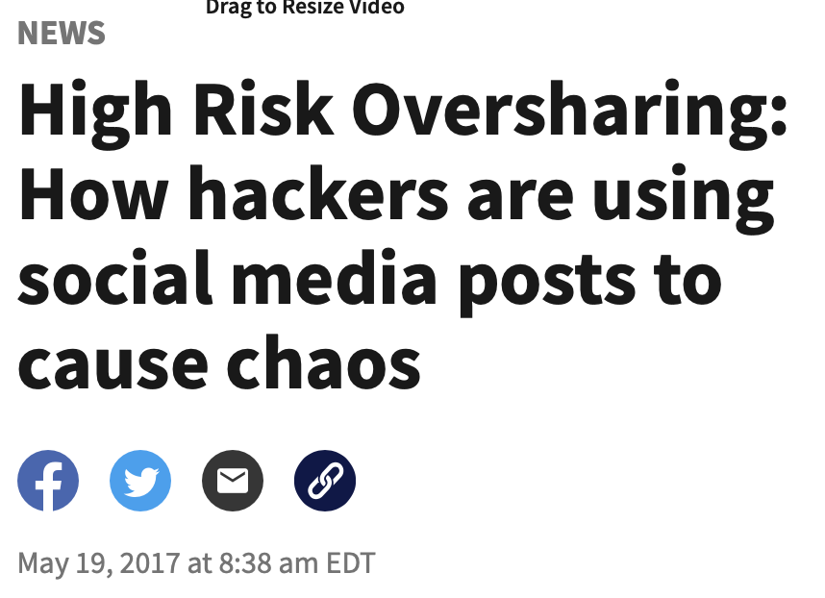


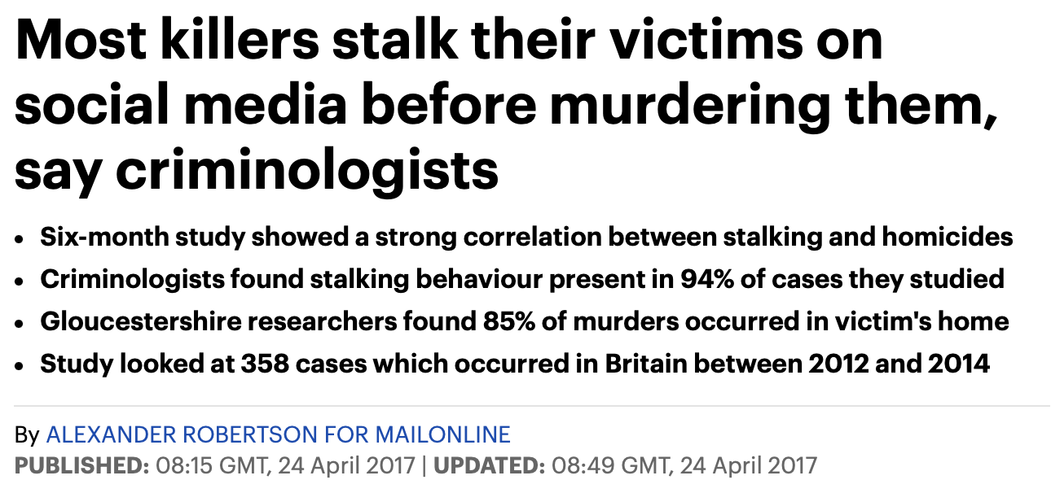
Real cases!
Risks of
a Digital
Footprint
Source: Cox Media Group (2017)
Source: Mail Online (2017)

Slide 12


🌐 Do I regularly search for my name online, to track how I am being perceived by others?
🧌 Do I refrain from judging quickly, and using hurtful language against others?
👣 Do I build a trustworthy
online reputation, among
family, friends and strangers?
🚨 Do I keep my data private, and report any breaches to online platforms/ authorities?
Secure Your Digital Footprint

Slide 13
Let’s talk:
Fake News

Slide 14
REAL
Or
FAKE
?

Slide 15

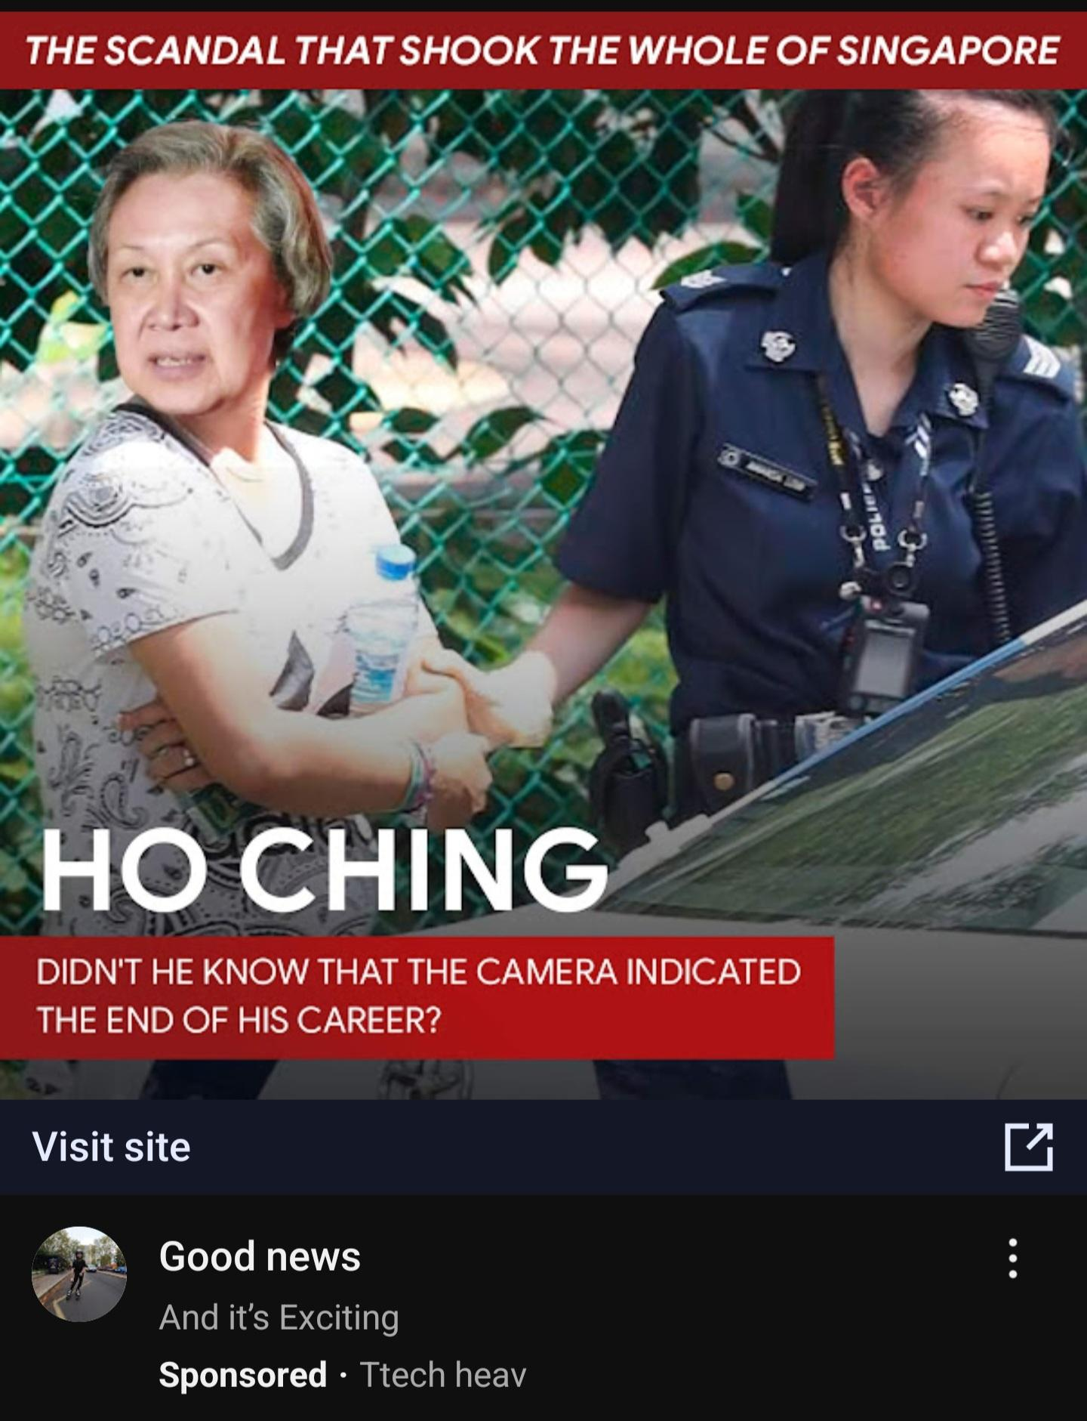
Real Or Fake?

Slide 16
FAKE
FAKE
Real Or Fake?

Slide 17
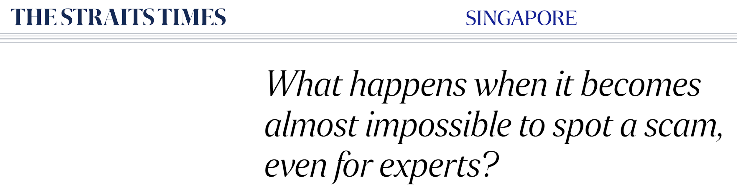
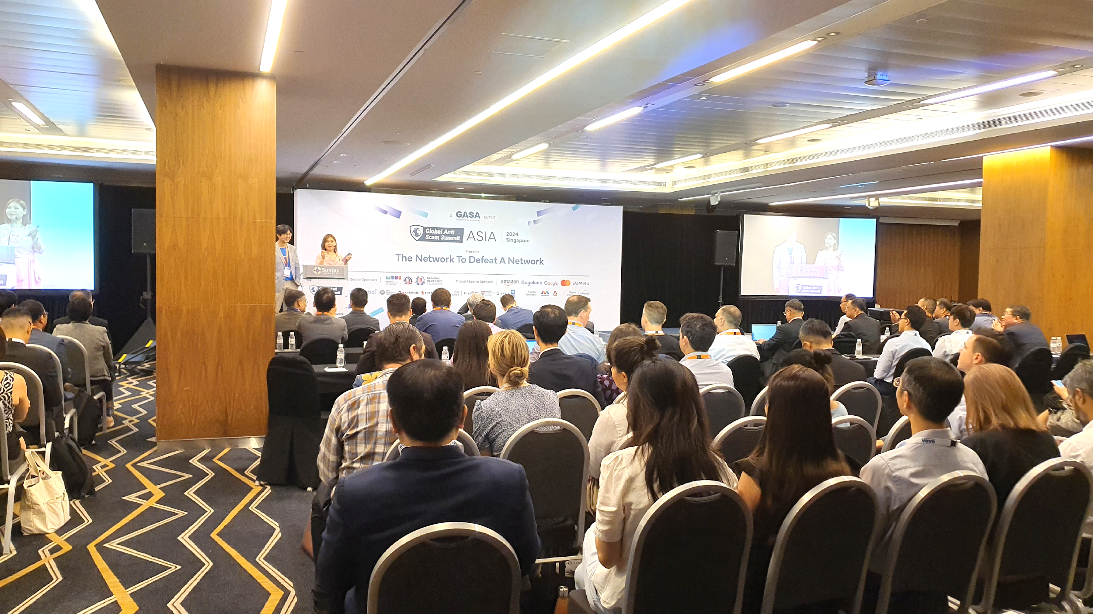

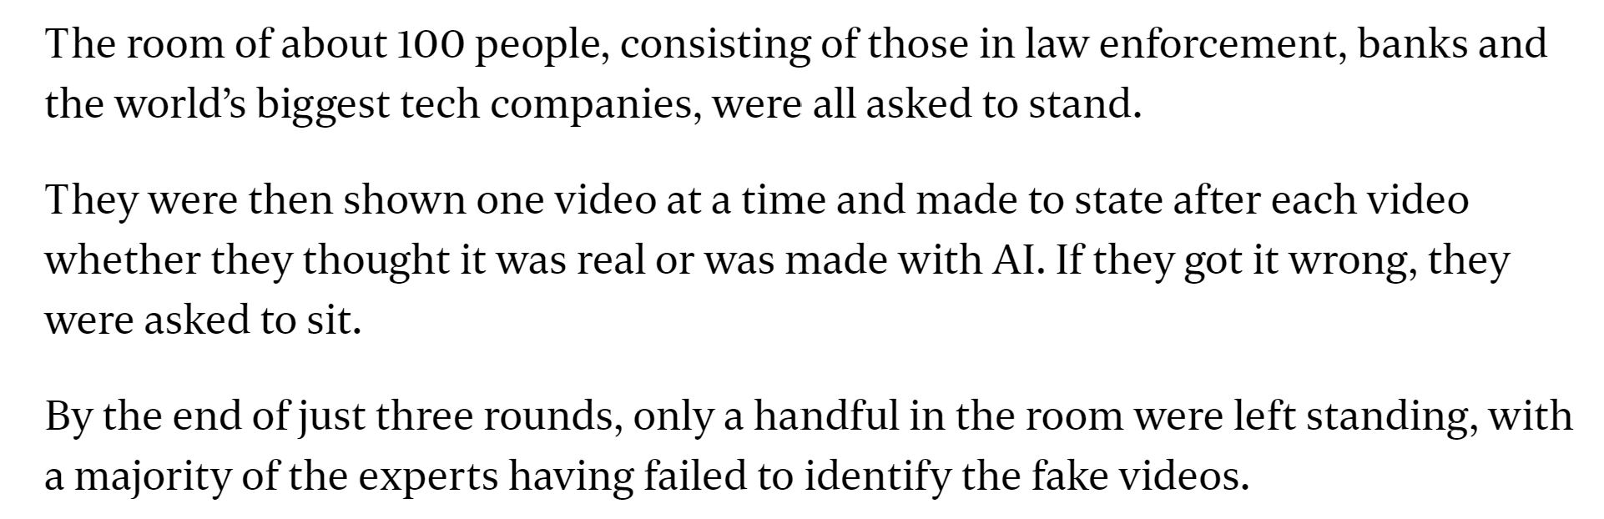
Did You Know?
Fake news
crisis has been
made worse
by GenAI…
Source: https://www.straitstimes.com/singapore/what-happens-when-it-becomes-almost-impossible-to-spot-a-scam-even-for-experts
Notes:
https://www.straitstimes.com/singapore/what-happens-when-it-becomes-almost-impossible-to-spot-a-scam-even-for-experts

Slide 18
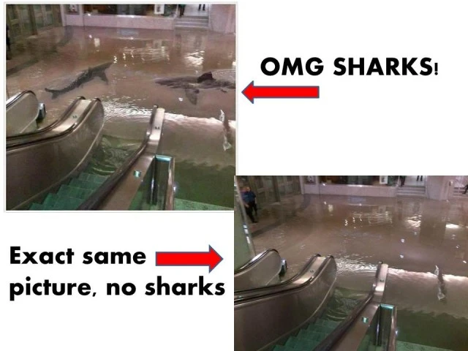
Hoax!
Sharks in a shopping mall!

Slide 19
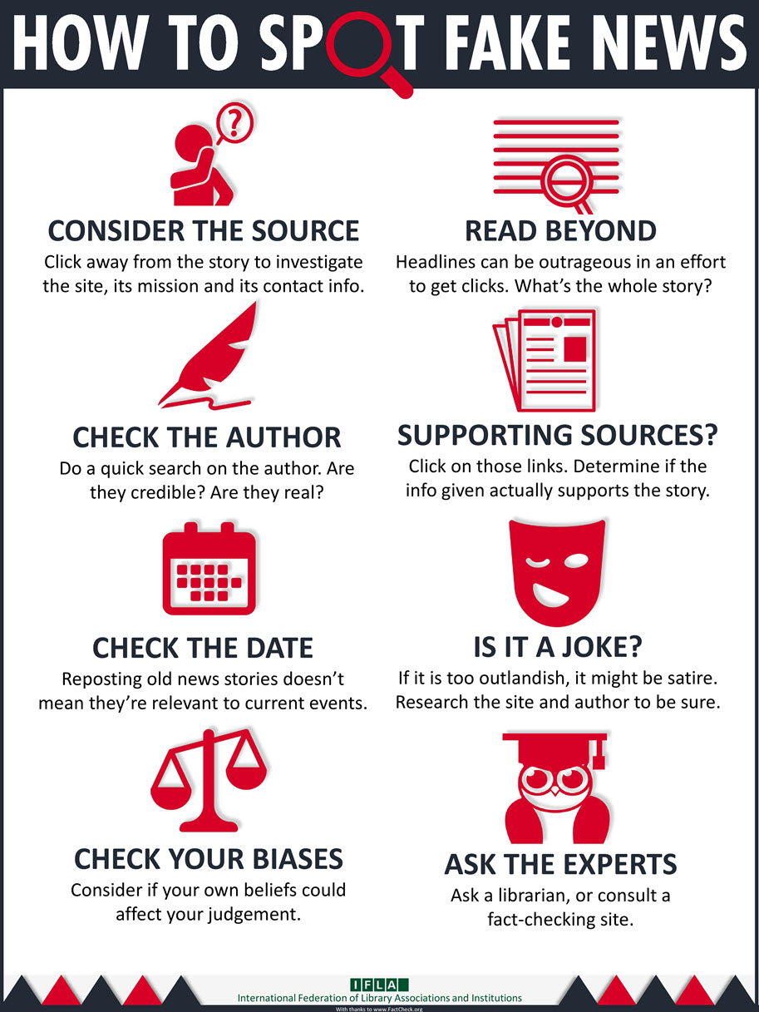

Did You Know?
Learn to Verify:
Gather and assess
evidence to check
information’s
accuracy
Tips To Spot Fake News

Slide 20
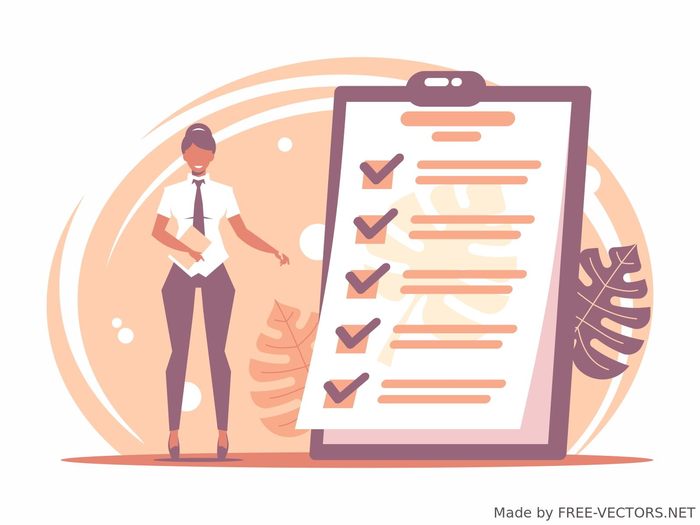

Not sure? Try this!
5 Step
Verification Framework:

Slide 21
Did You Know?
5 Step
Verification Framework:
1. ORIGIN
“Am I looking at
the original piece
of content?”
3. DATE
“When was the
piece of content
captured?”
5. MOTIVATION
“Why was the
piece of content
captured?”
2. SOURCE
“Who created the
piece of content?”
4. LOCATION
“Where was the
piece of content
captured?”

Slide 22
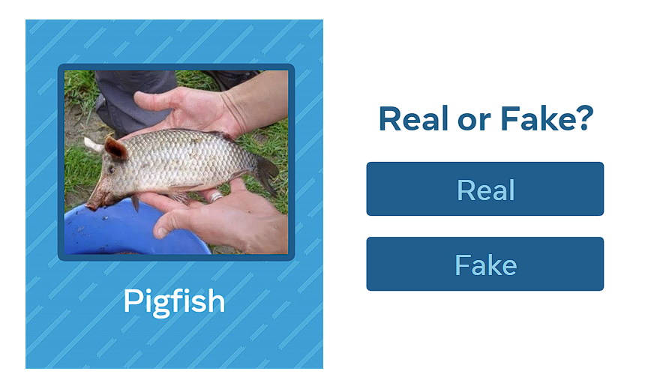
Case Study
Verify:
Real or Fake?

Slide 23

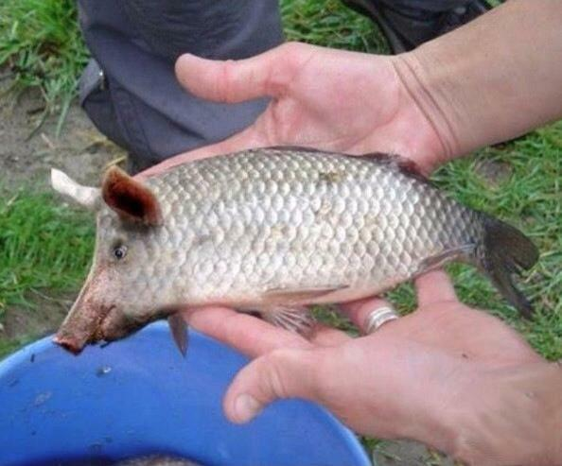

Origin: Unknown
Source: Facebook
Pigfish
Let’s Analyse!

Slide 24
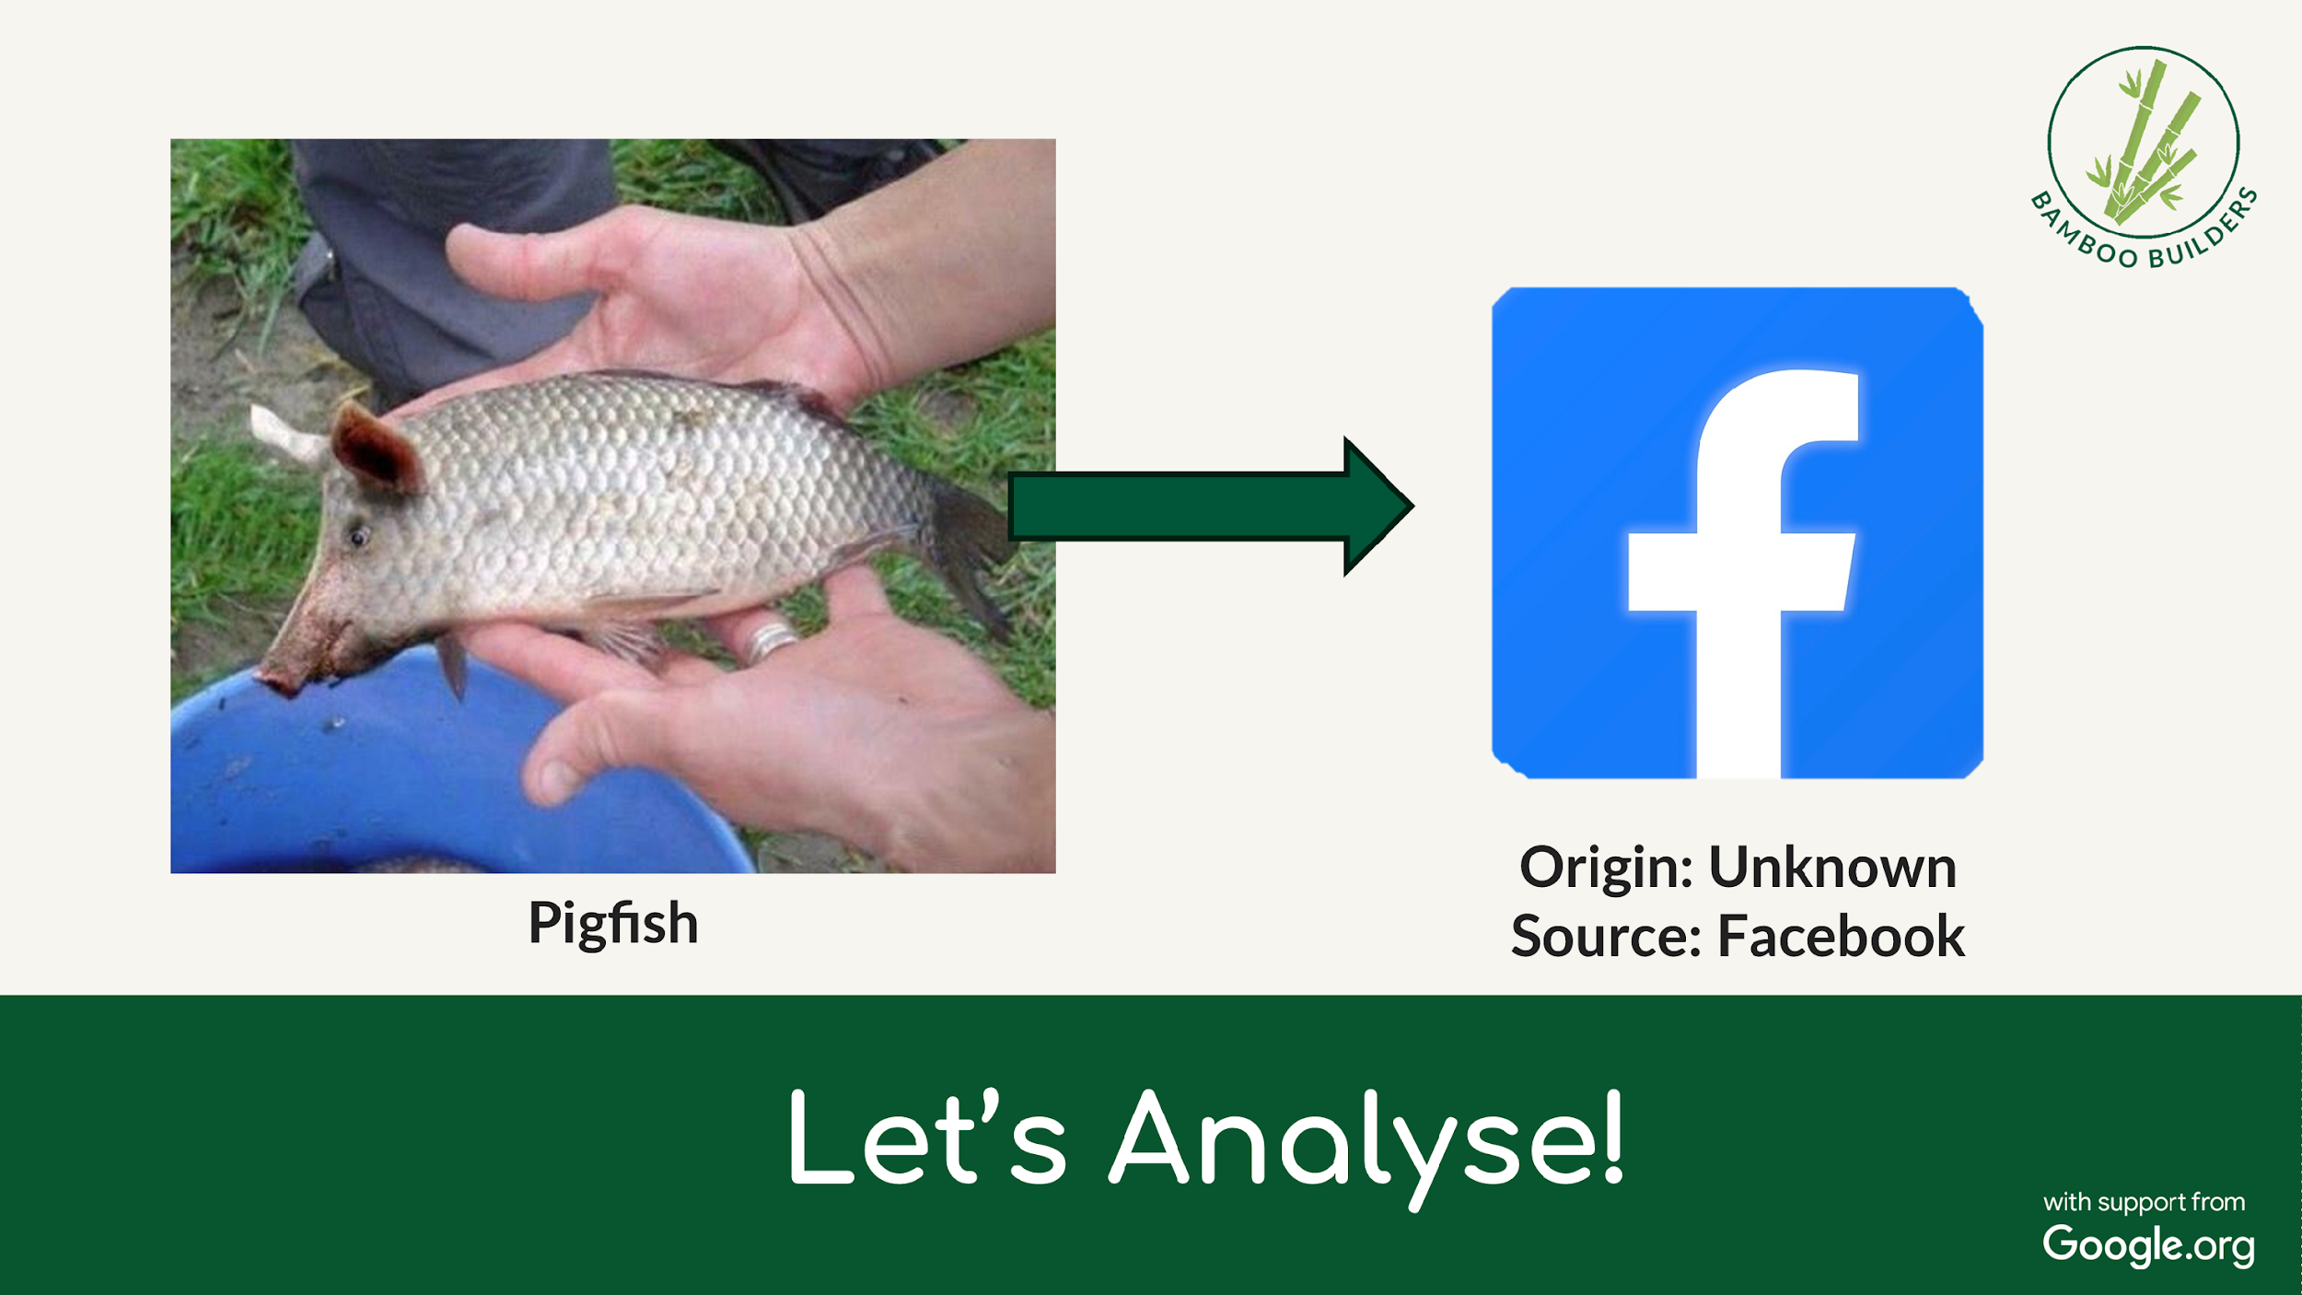
Is Facebook a reliable source of information?

Slide 25
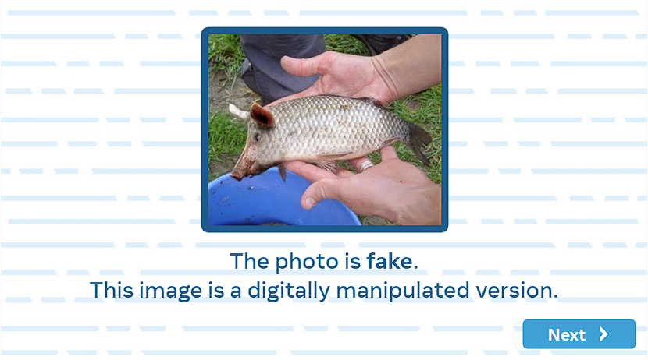
Case Study
Verify:
Real or Fake?

Slide 26
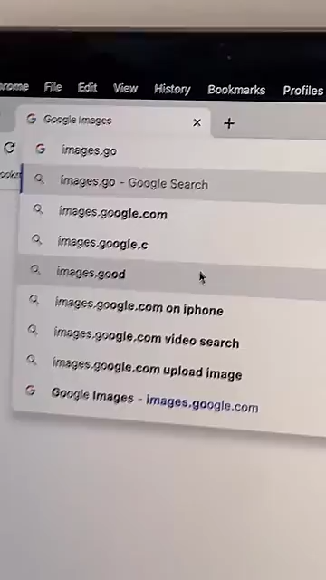
Alternatively:
Google
Reverse Image Search
1. Upload an image.
2. Results will show if said image has been altered or used elsewhere!
Source: https://www.youtube.com/shorts/HI0FUyRkgvs?feature=share
Notes:
https://www.youtube.com/shorts/HI0FUyRkgvs

Slide 27
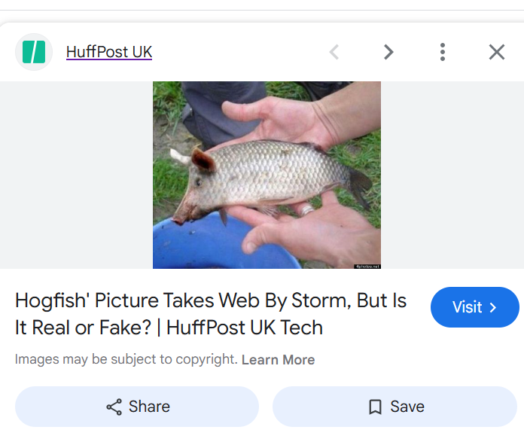
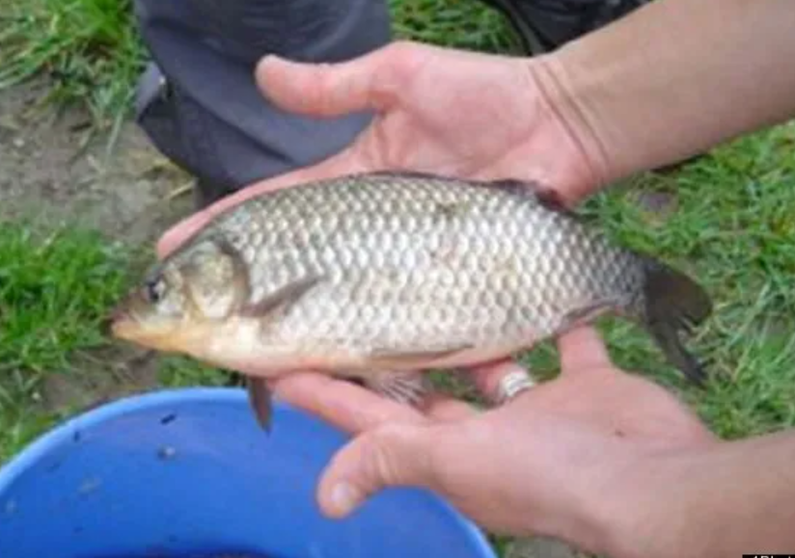
Let’s Try It Out!

Slide 28
Discuss: What might MOTIVATE someone to post this?
Notes:
To go viral, to become famous, to create shock/fear

Slide 29
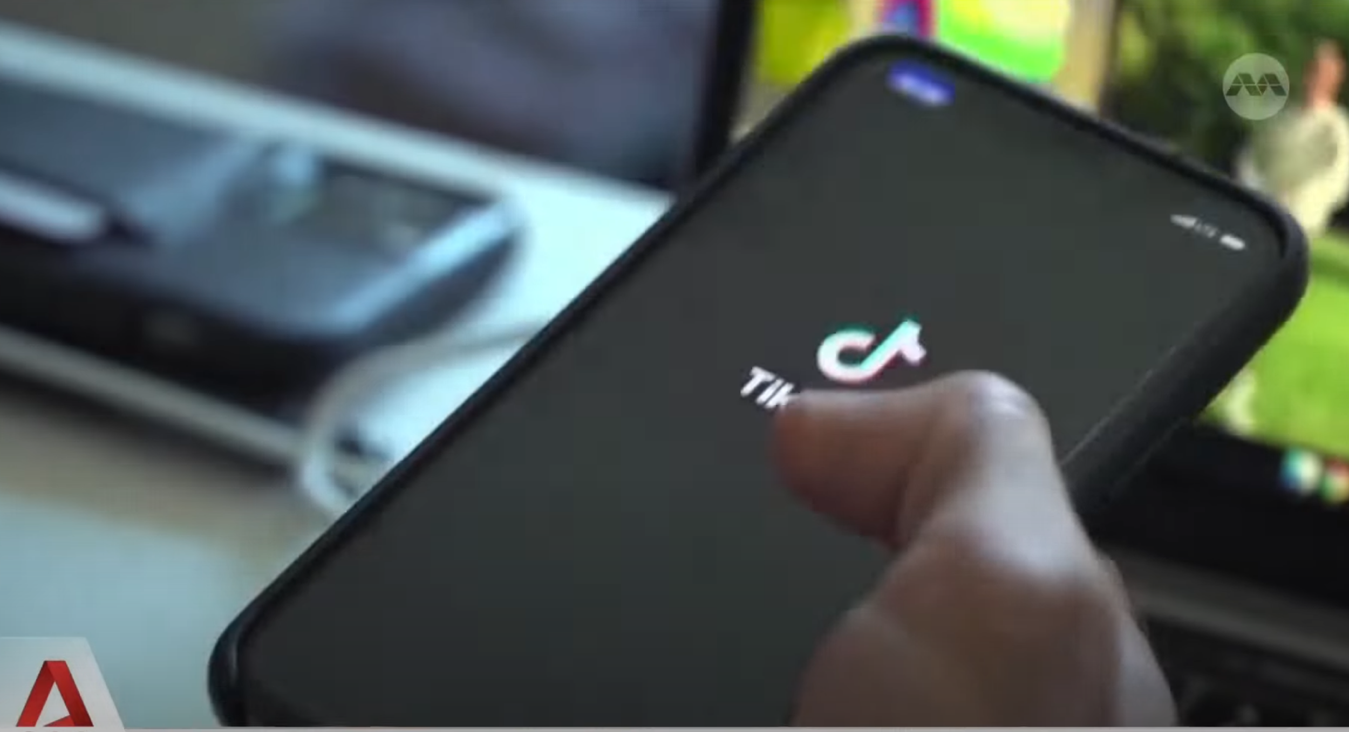



Did You Know?
Fake news is everywhere!
Research Firm Milieu found that 60% of SG youths <18 years old have seen fake news on social media…
What is the value of Spotting Fake News & Responsible Sharing?
Source: https://www.youtube.com/watch?v=cbAgGvTLup8&list=LL&index=16
Notes:
https://www.youtube.com/watch?v=cbAgGvTLup8&list=LL&index=16

Slide 30

👣 Do I do the 5 Step Verification framework and check the Origin, Source, Date, Location, and Motivation?
🧌 Do I use Reverse Image Search when I am unsure?
🚨 Do I only share information which I have confirmed to be true?
Verify information online

Slide 31
Let’s Talk:
Staying Protected From Cyberthreats

Slide 32
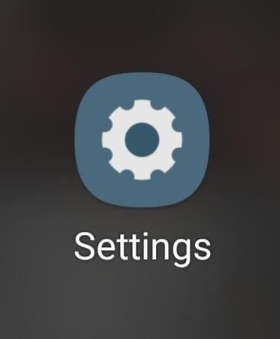
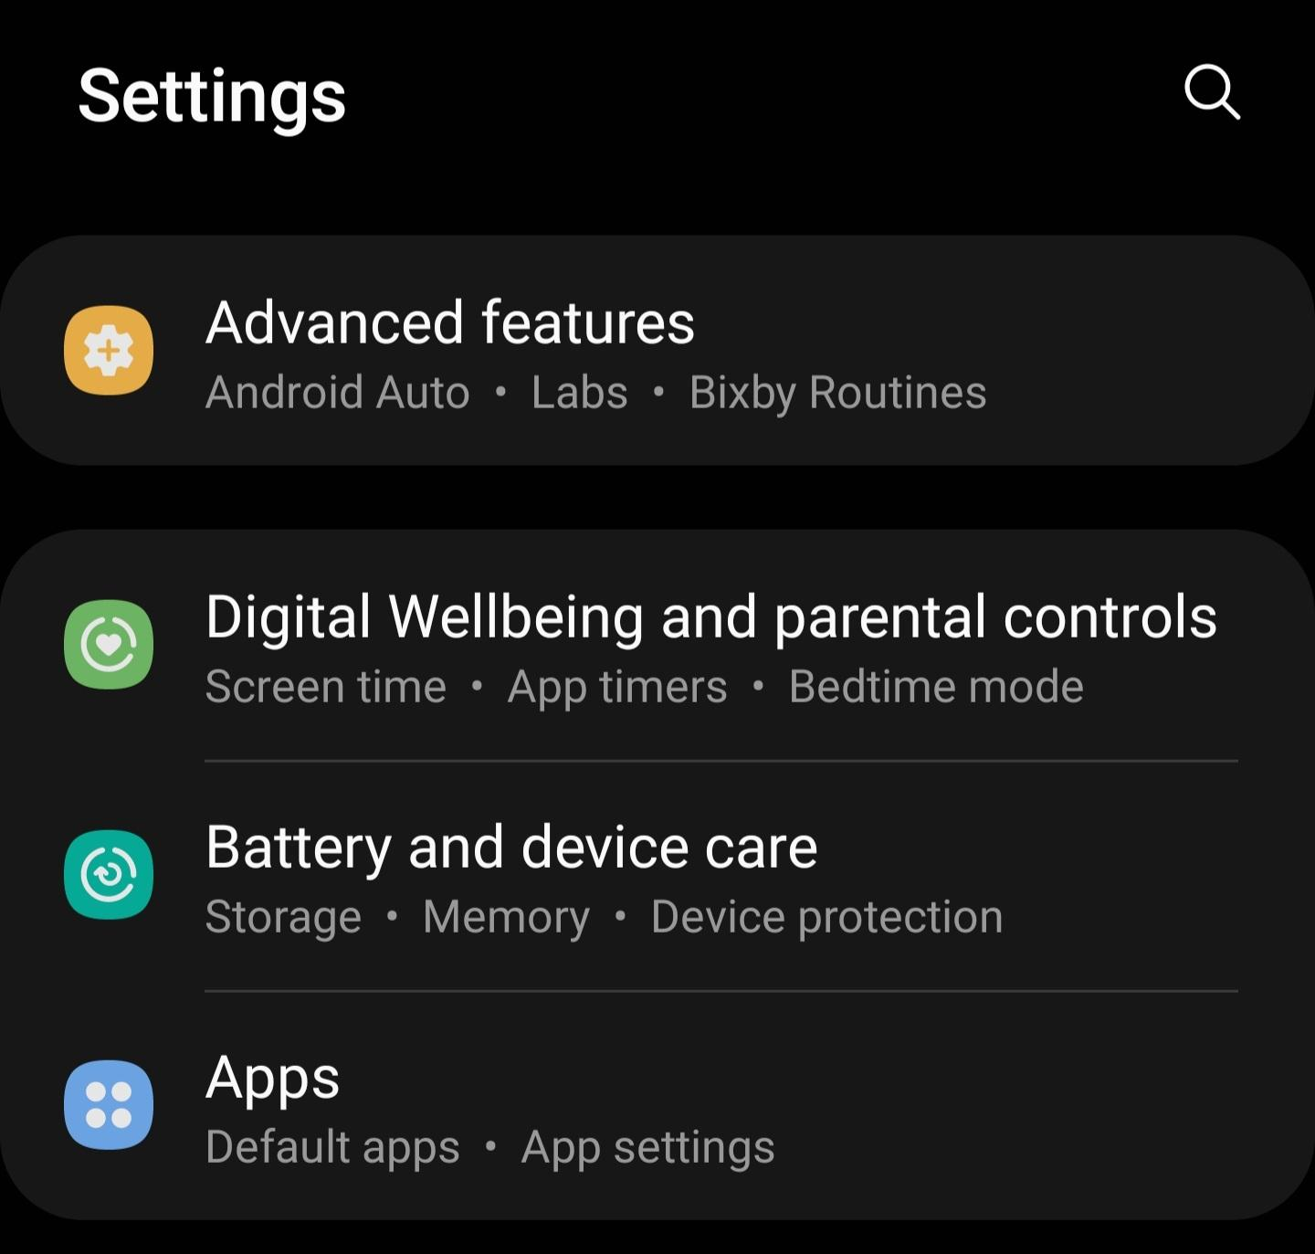
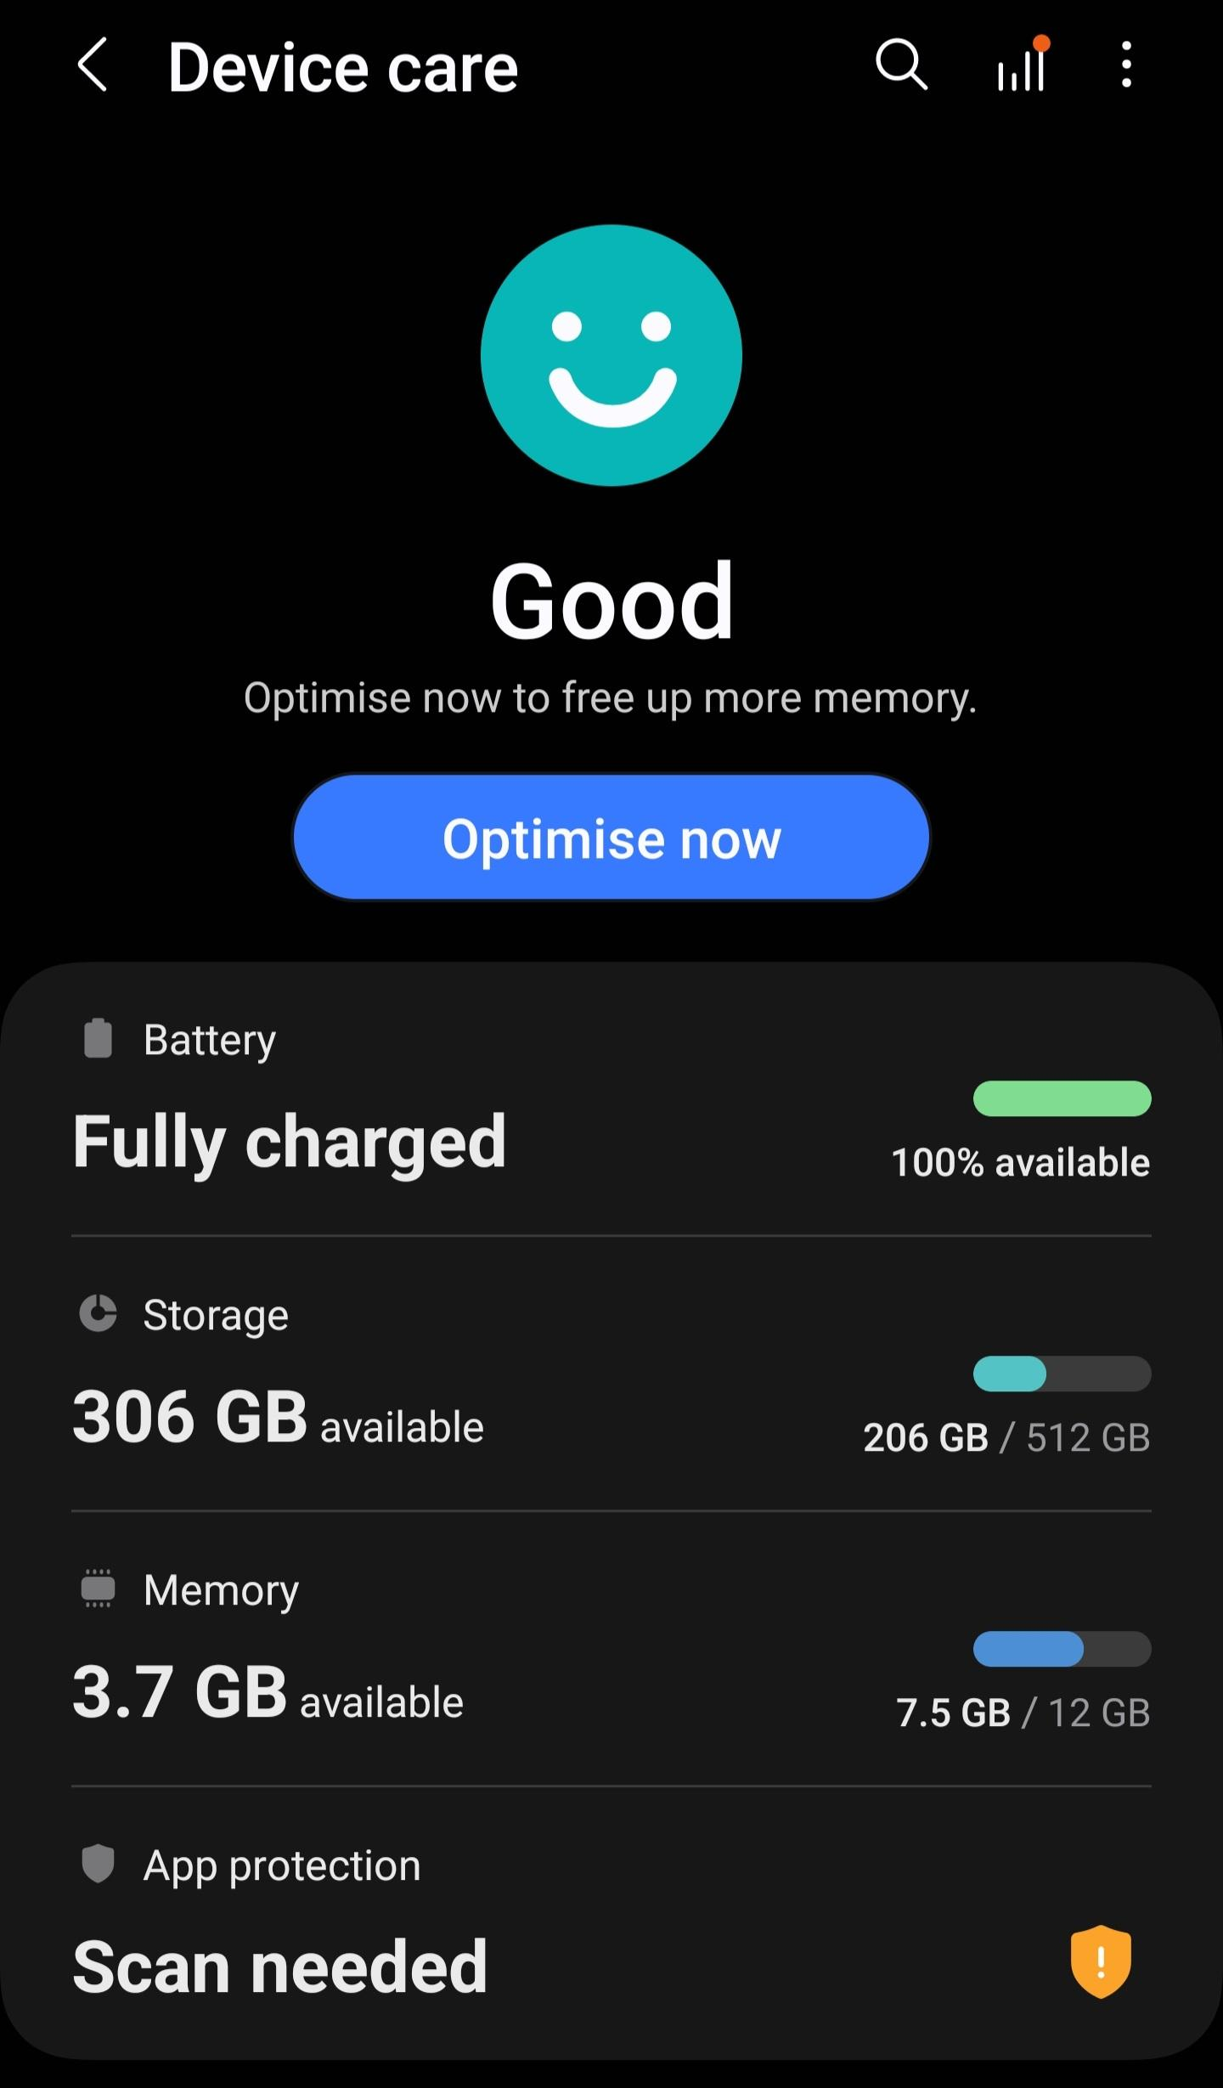
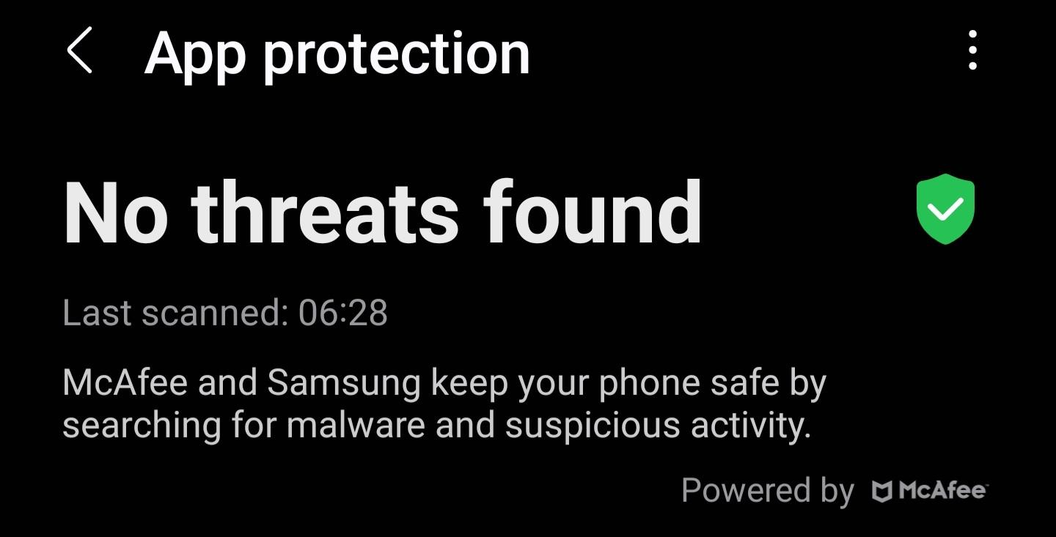
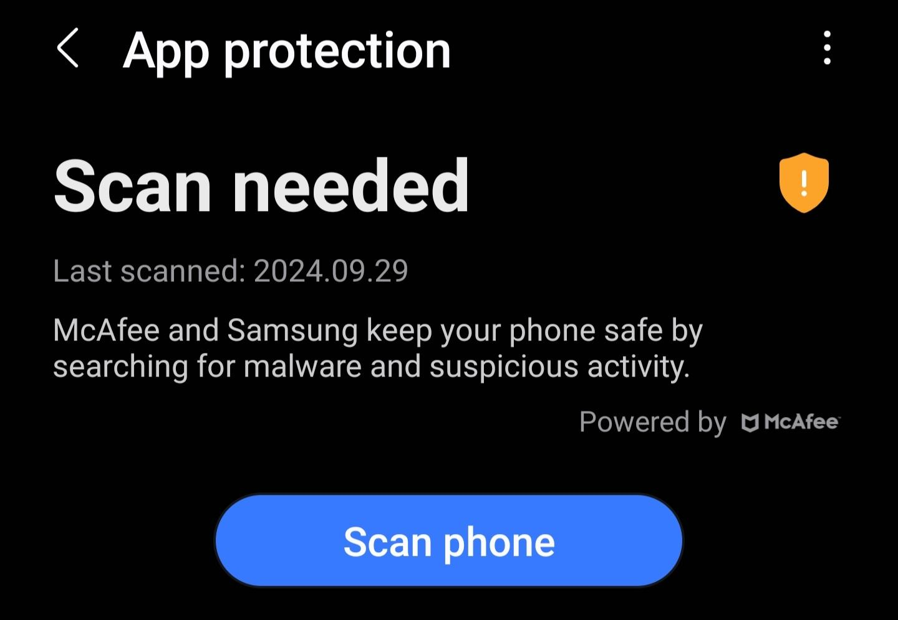
Tip
🔎 Steps to scan your phone regularly!
(Android)

Slide 33
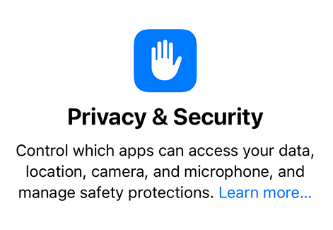

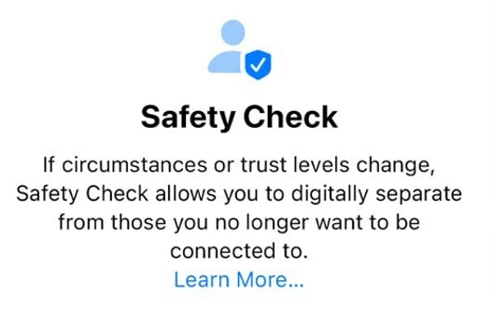
Did You Know?
🔎 Steps to scan your phone regularly!
(iPhone)

Slide 34
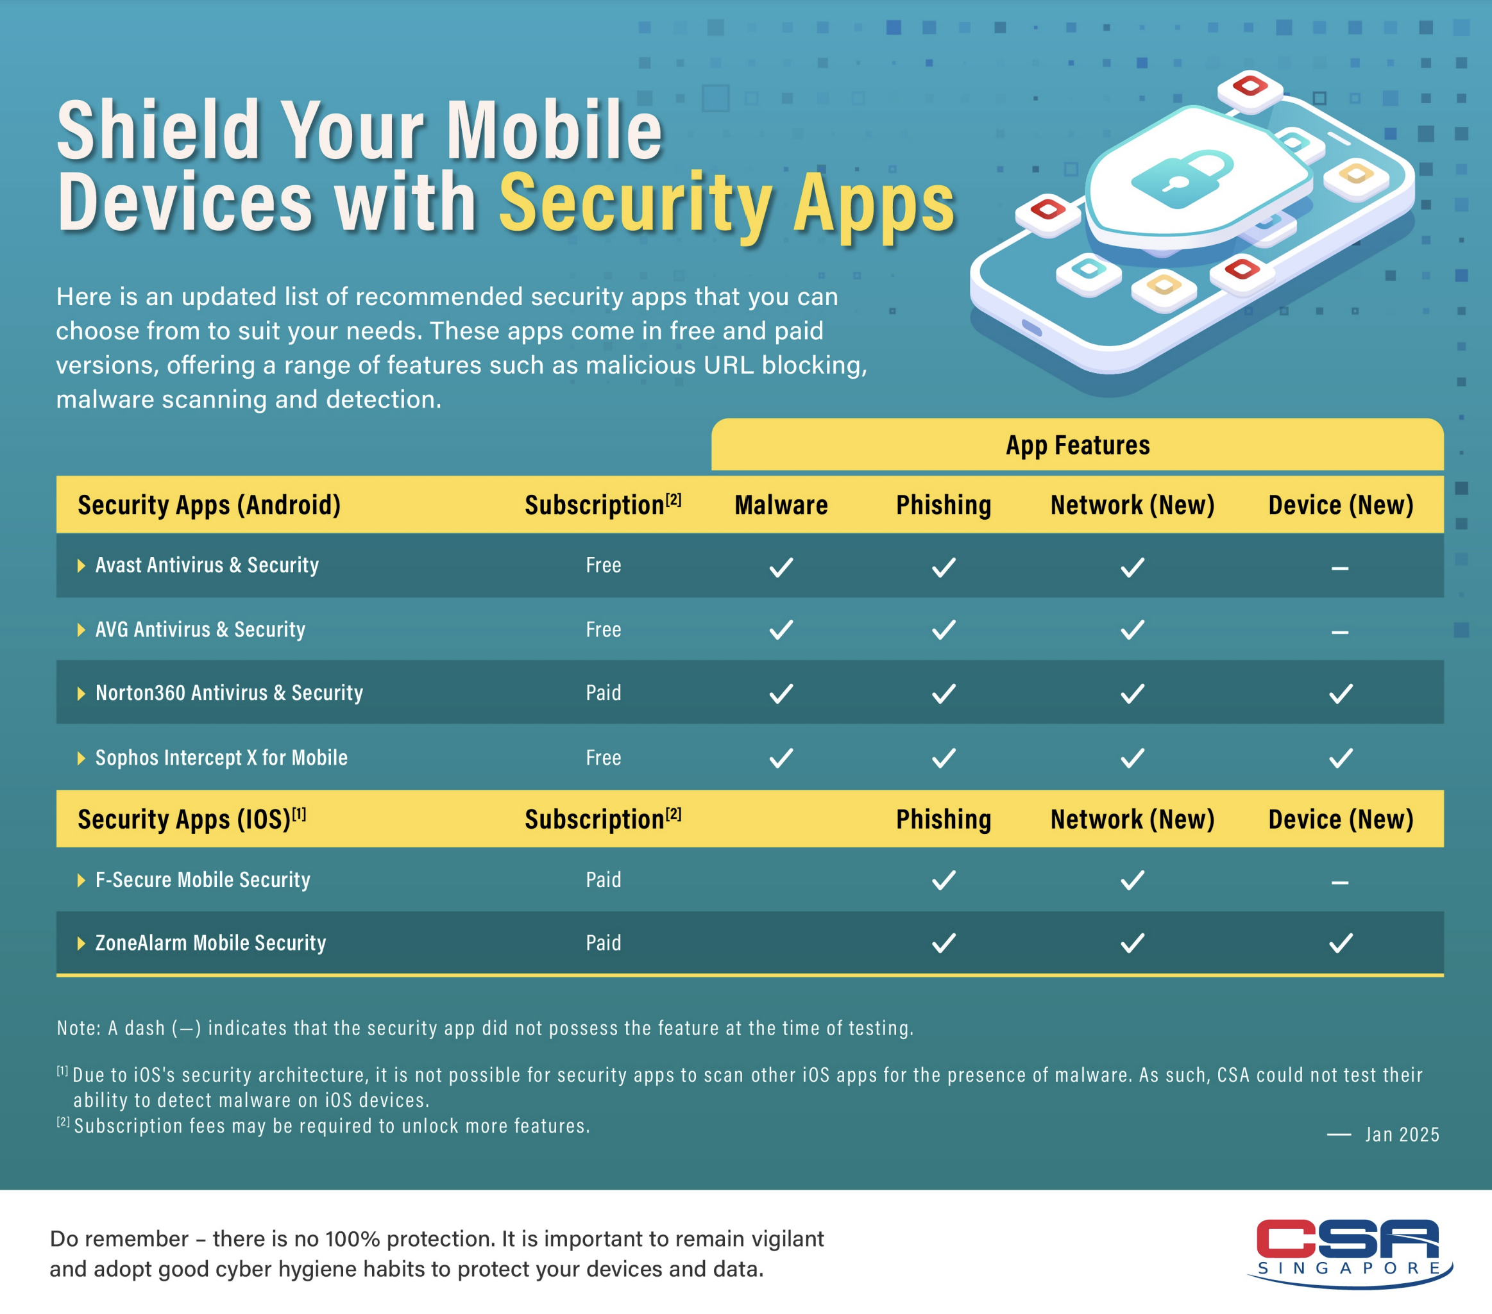
Did You Know?
🛡️ Recommended Security Apps
from the Cyber Security Agency of Singapore!
Source: https://www.csa.gov.sg/resources/tips-and-resources/recommended-security-apps-list/
Notes:
https://www.csa.gov.sg/news-events/press-releases/annex-b-list-of-recommended-anti-virus-apps

Slide 35
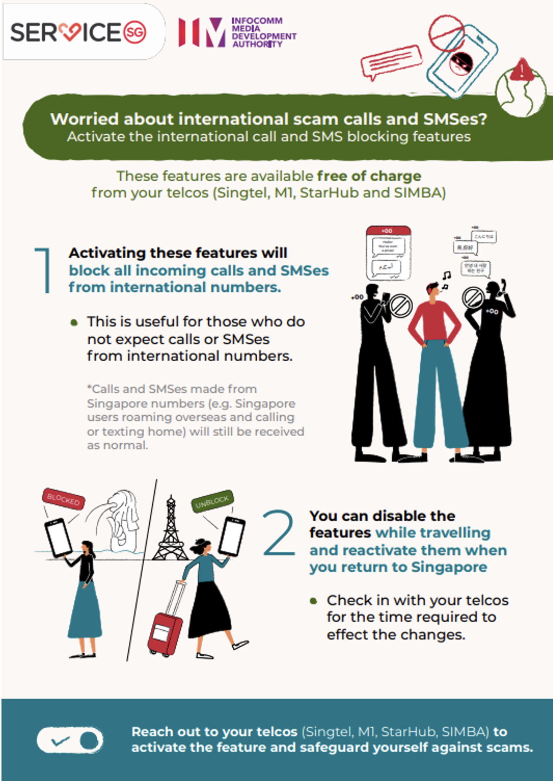




Did You Know?
📵
Contact your Telco to block calls and SMSes from International numbers…
1688
1627
1633
SMS ‘BLOCKINTSMS’
to 1218
SMS ‘4’ to 1218
(To block calls)

Slide 36
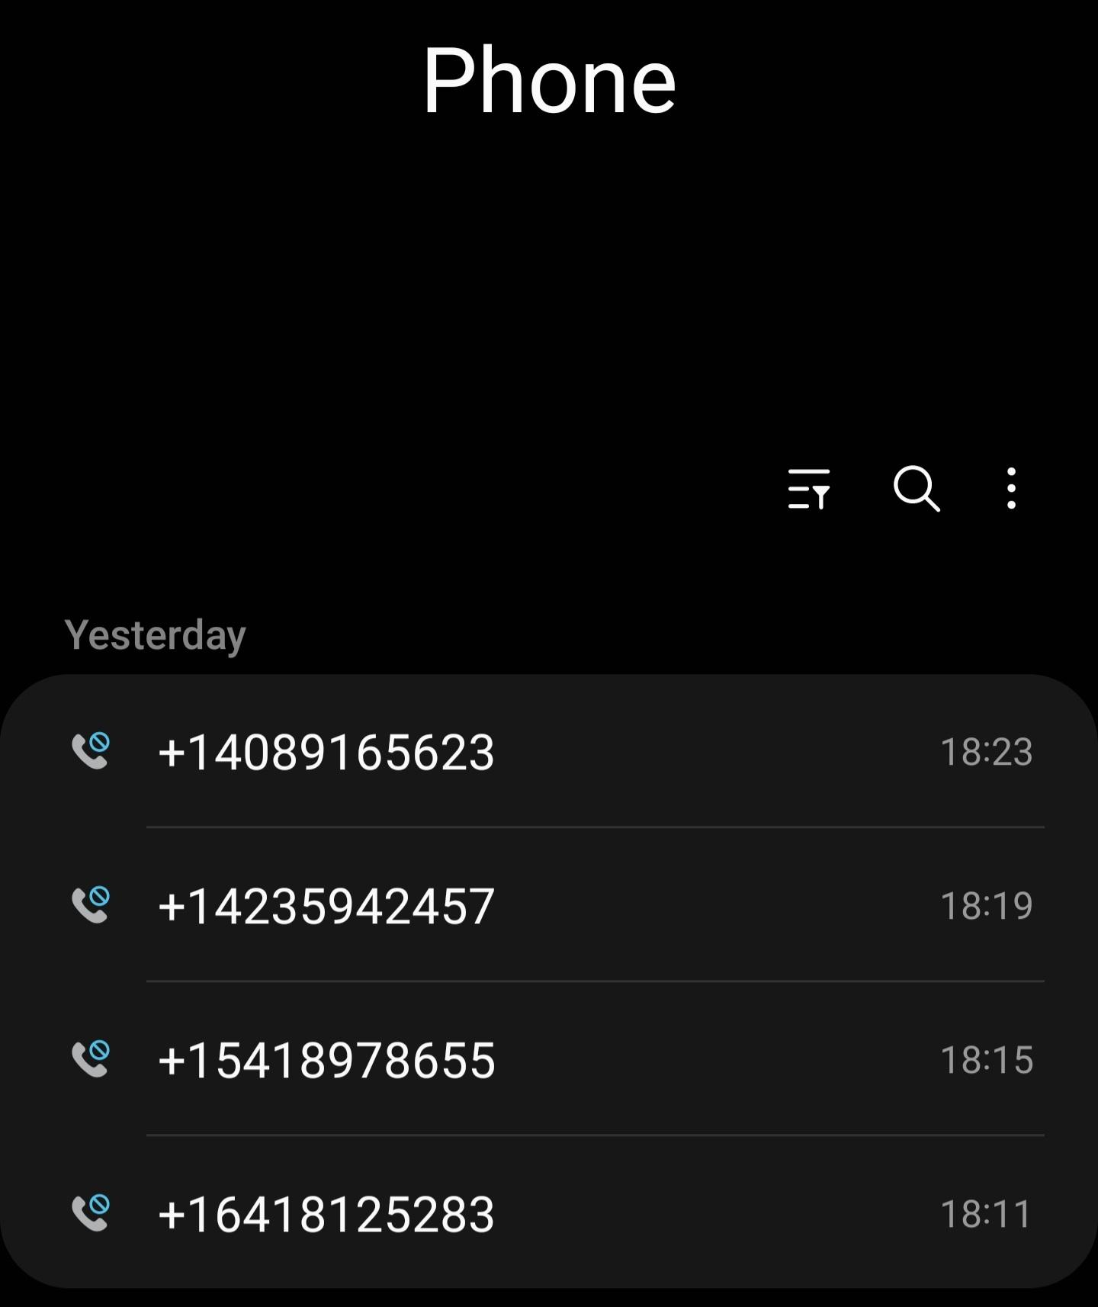
Did You Know?
📵
…because you do not want to end up with this!
Spammed multiple calls from international numbers within 10 minutes!

Slide 37
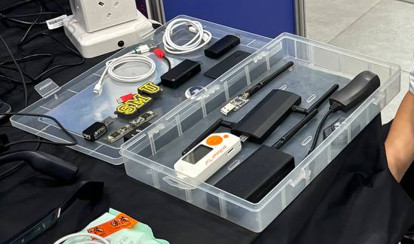
Did You Know?
Your devices can also be sabotaged manually!
E.g.
A charging cable with a hidden malware chip!
Various bugged devices, presented by the
SMU Cyber Security Awareness Team (CSAT)

Slide 38
Did You Know?
Your devices can also be sabotaged manually!
E.g.
A charging cable with a hidden malware chip!
Make sure to only buy devices from trusted and official sources!
Various bugged devices, presented by the
SMU Cyber Security Awareness Team (CSAT)

Slide 39


📲 Do I download Apps from official App stores only?
🛡️ Do I have:
1. OS Security patches?
2. Firewall?
3. Anti-virus software?
4. Screensaver passwords?
5. Remote-access disabled?
🔄 Do I update my Apps
and check reviews on
their safety?
🔎 Do I conduct a
phone-scan for
viruses regularly?
📵 Do I get my Telco to block calls and SMSes from international numbers?
Secure Your Devices

Slide 40
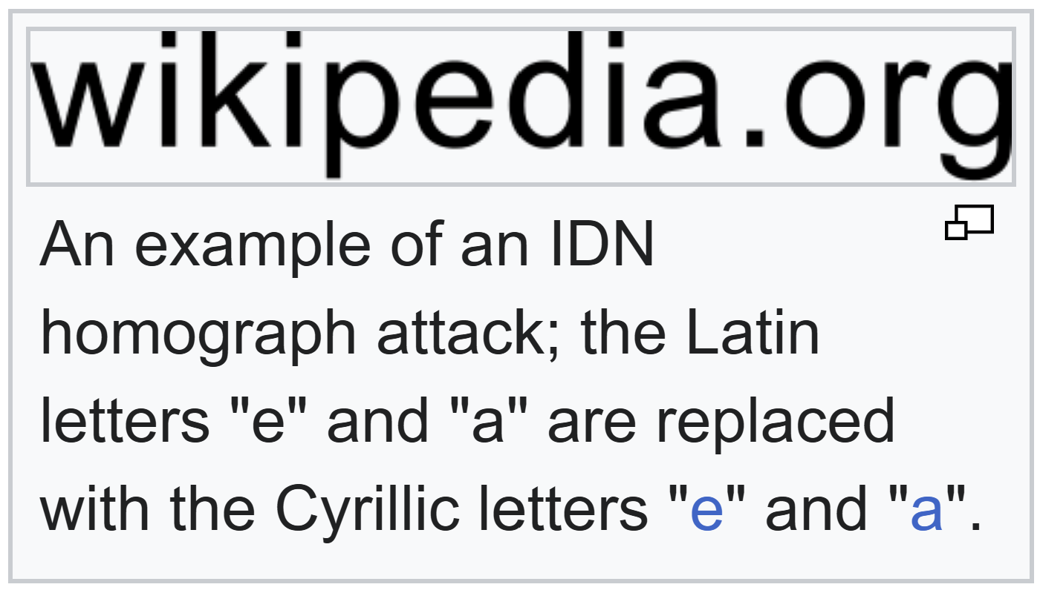
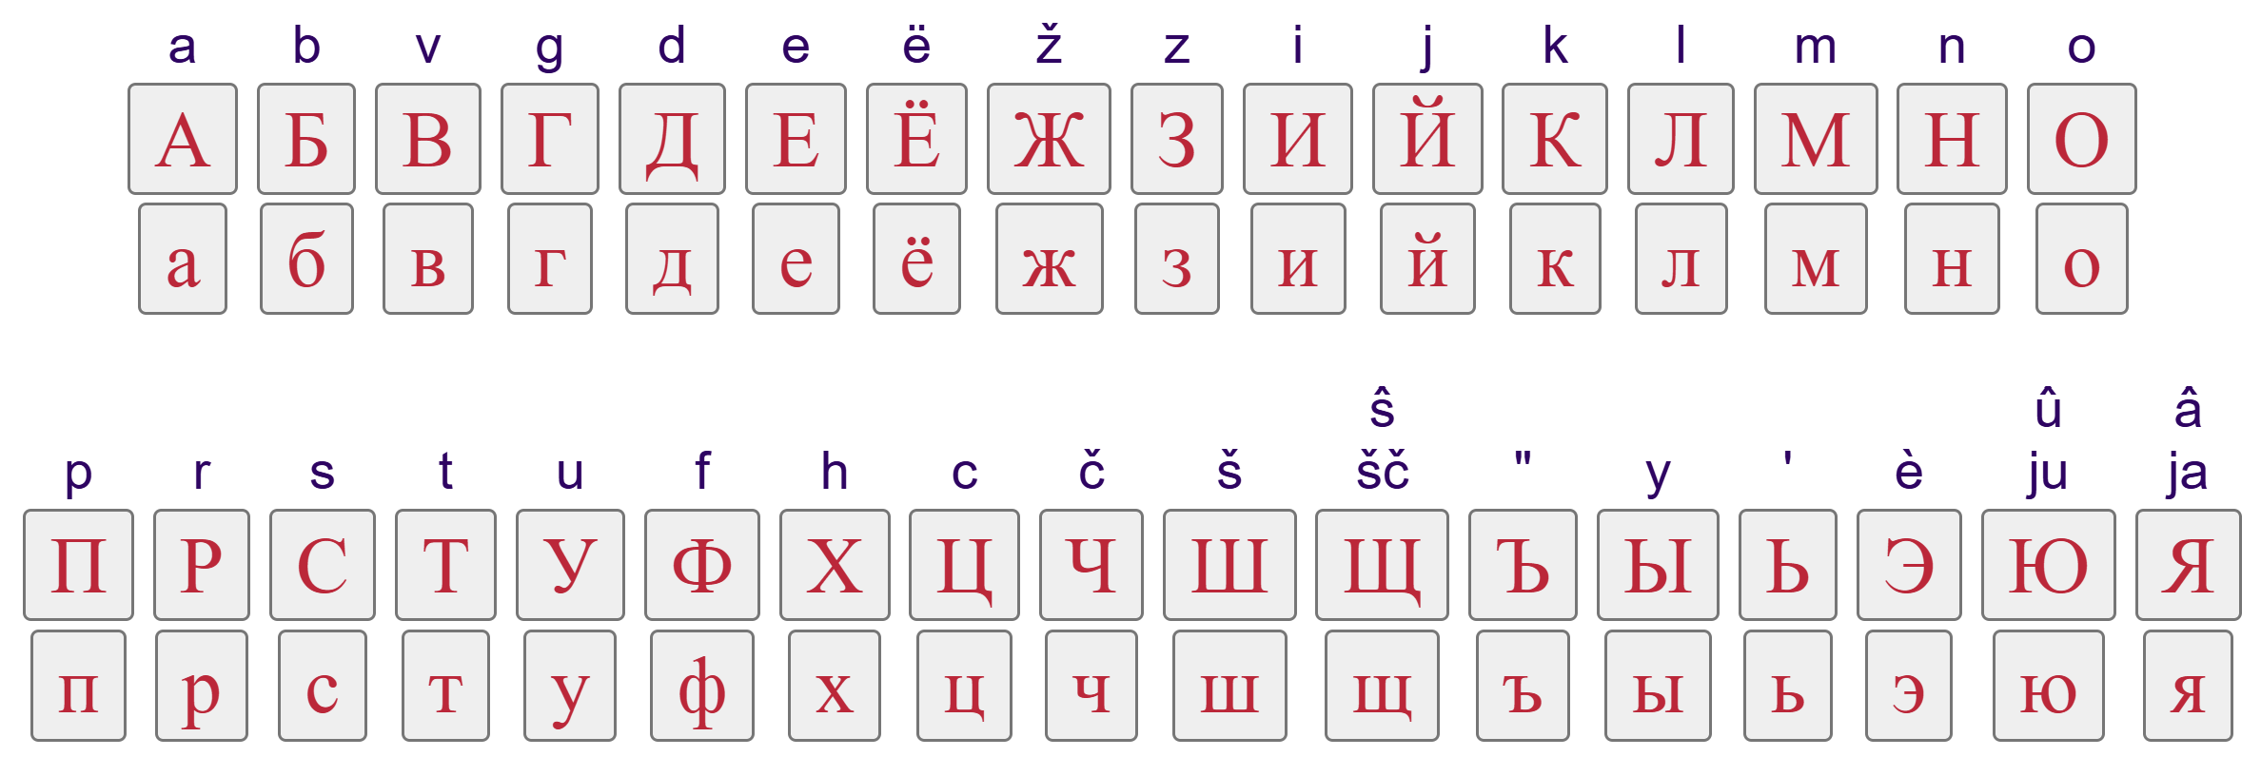
Did You Know?
*IDN:
Internationalised
Domain Name
👀
Beware homograph attacks!
Scammers can use other alphabets to create fake website links!
Cyrillic script:
Source: https://en.wikipedia.org/wiki/IDN_homograph_attack, https://www.lexilogos.com/keyboard/russian.htm

Slide 41
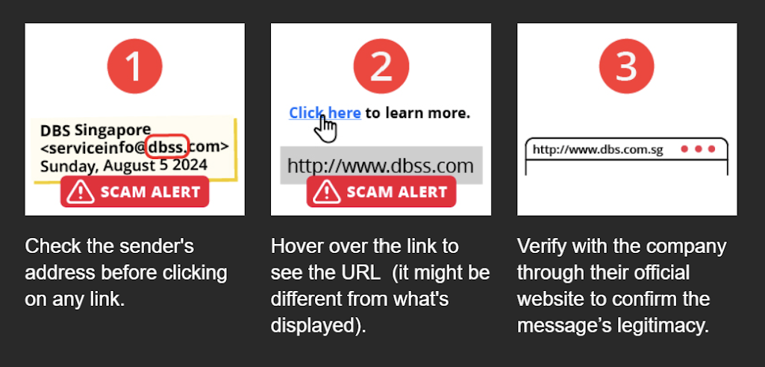
Did You Know?
Be wary of website links with only ‘http’ (unsecured).
Secure websites have ‘https’.
👀
Avoid clicking on weird internet links...
Source: https://www.dbs.com.sg/personal/deposits/bank-with-ease/how-to-spot-a-scam & Email Circular from serviceinfo@dbs.com

Slide 42
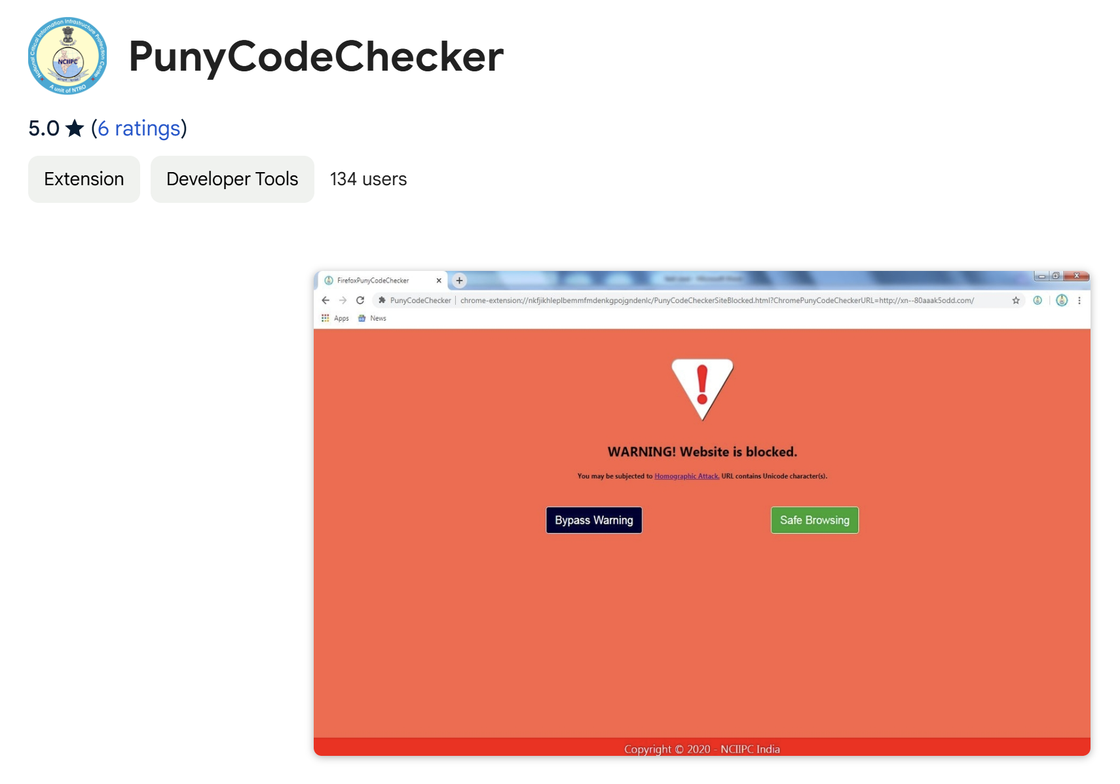
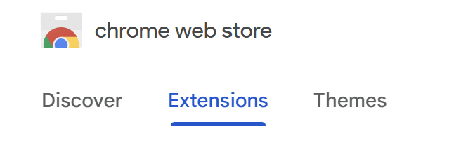
Did You Know?
👀
You can install a browser extension tool, to detect fake websites that use different scripts.
Source: https://chromewebstore.google.com/detail/punycodechecker/bodgongblbmaghghjlfphlbpbiepapne

Slide 43

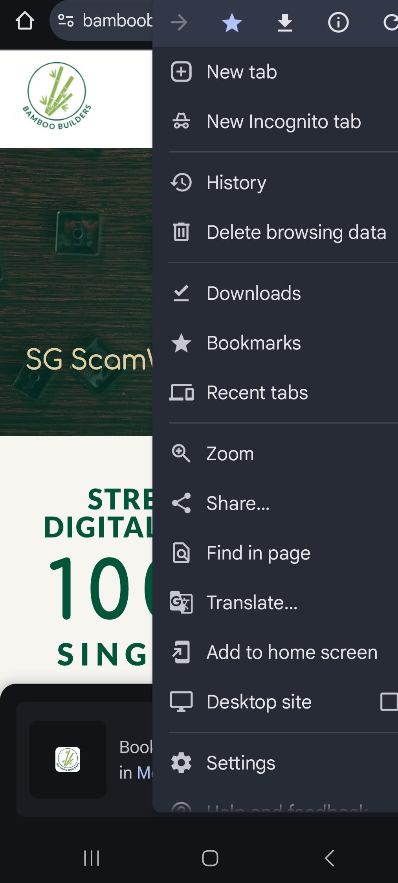
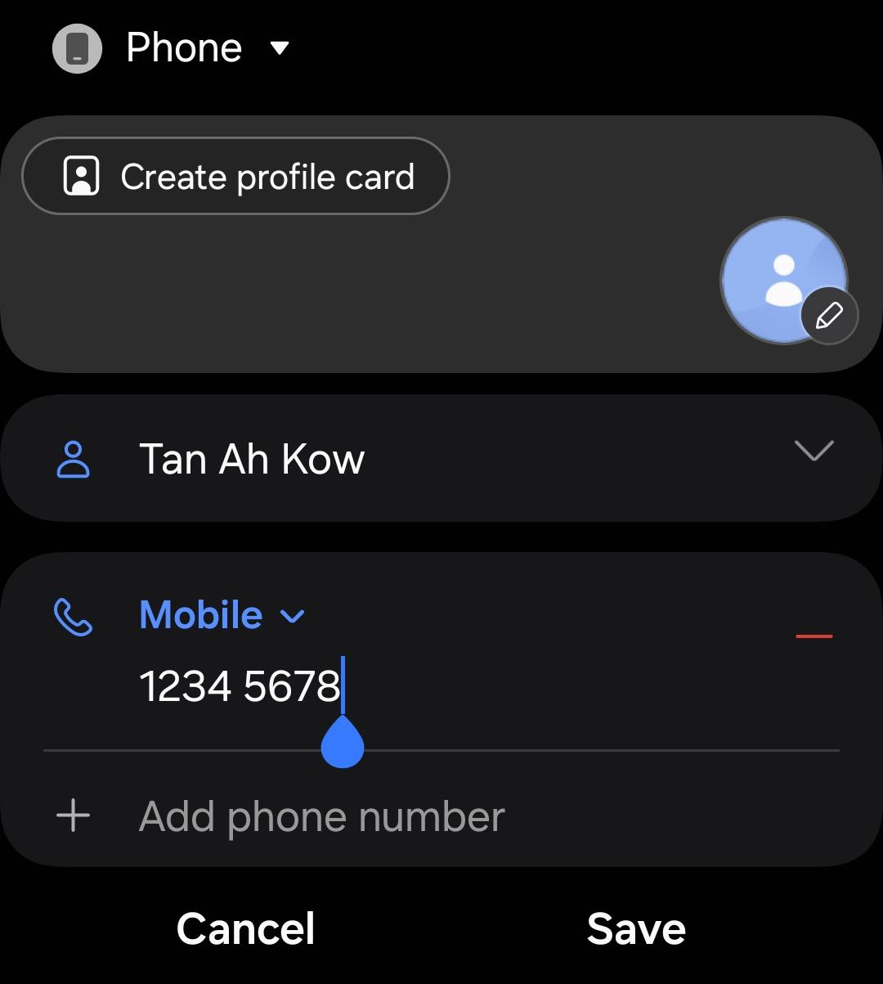
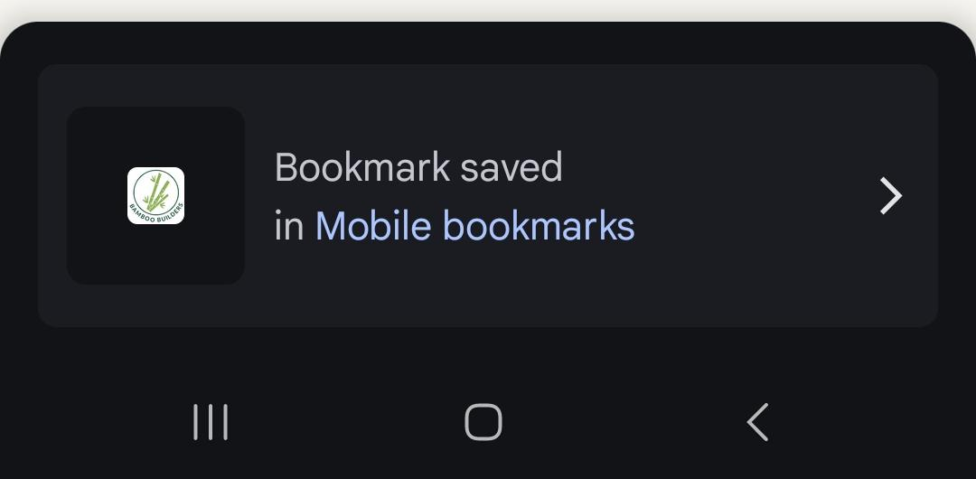

Did You Know?
💬
Assign names to phone numbers.
Bookmark trusted websites.
This way, you will not get mislead by fake numbers or links!

Slide 44
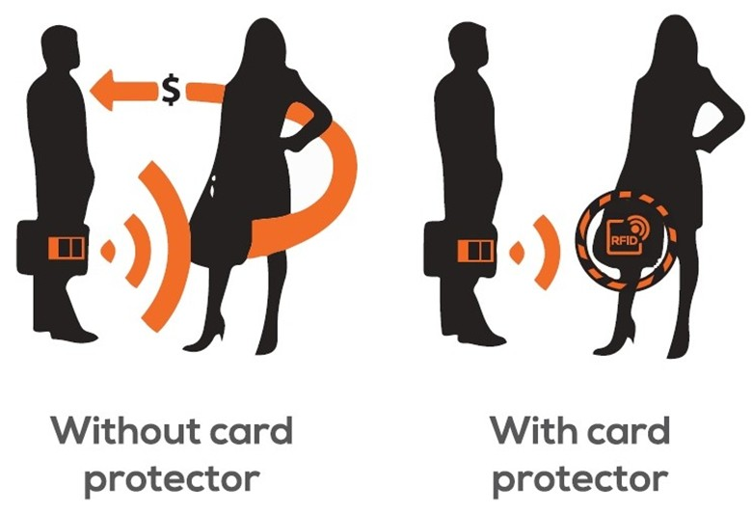
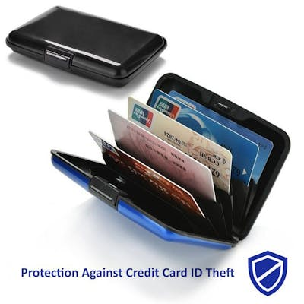
Did You Know?
Lovely day,
ma’am!
Lovely day-
d*mn!
👛
Beware Electronic Pickpocketing!
RFID card cases protect against Credit Card ID Theft
(from skimming devices)!
Without card protector
With card protector

Slide 45
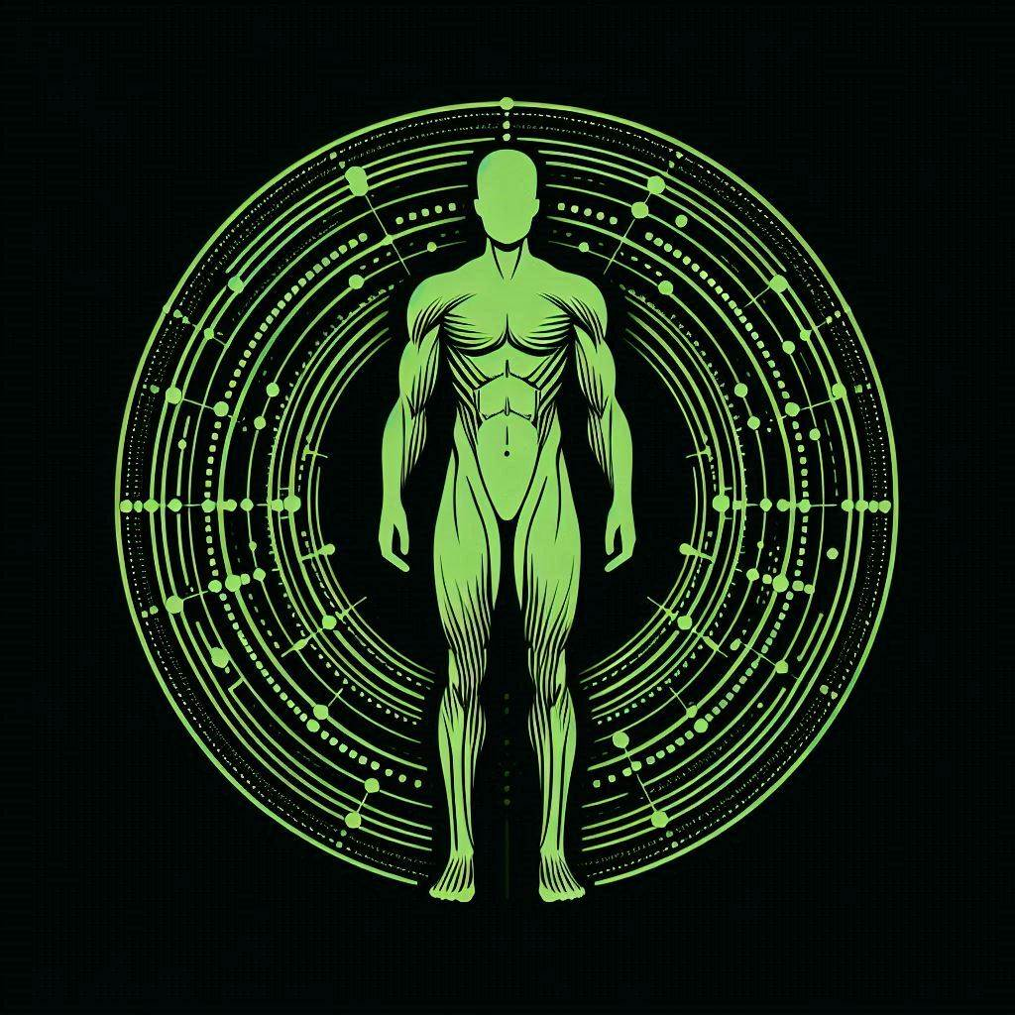
🧠 Do I stay on trusted platforms/ VPNs, and check with my social circle/ public news about suspicious deals?
💬 Do I have a shared Safeword with my family and friends,
so they know it is really me?
👀Do I spot and avoid
clicking on weird
internet links?
👛 Do I carry an RFID card case, to shield my credit cards from electronic pickpocketing?
👄 Do I avoid sharing
personal data online?
👂Do I avoid answering calls from unknown numbers?
Secure Your Habits
Notes:
https://www.giftmarket.com.sg/item/1171/hard-cover-rfid-card-case/

Slide 46

Congrats on finishing this module!
Thank You!

Slide 47







With Support From
http://www.bamboobuilders.org/sgscamwise …
Let’s Build Change Better
@bamboobuilders

